Slide 1



Noida Institute of Engineering and Technology, Greater Noida
JSP
Unit: II
Subject Name: ADVANCED JAVA PROGRAMMING
Faculty Name:
Neetu Rajput
IT&M.Tech(Int.)
Course Details: B Tech 6th Sem

Slide 2

Faculty Profile
Experience | Details
Total Experience | 4 Yrs
Teaching Experience | Dec 2021 to till now Subject Taught/Lab: OOT using JAVA, Advanced java programming/Lab, Artificial Intelligence and Web Technology, Computer network Subject Interest: JAVA, Computer network, Artificial intelligence
Industrial Work Experience | 2 Years Worked as Executive Engineer in Pratyush Infosolution Pvt. Ltd. Feb 2021 to Nov 2021) Worked as Patent Engineer in Ennoble IP, Sector-15,Noida( Nov 2019 to Oct 2020)

Slide 3
Faculty Profile
Education Background | Details
M.Tech in Computer Science Engineering(2017-19) | Galgotias University, Greater Noida
B.Tech in Computer Science Engineering(2013-17) | ACET, Aligarh

Slide 4
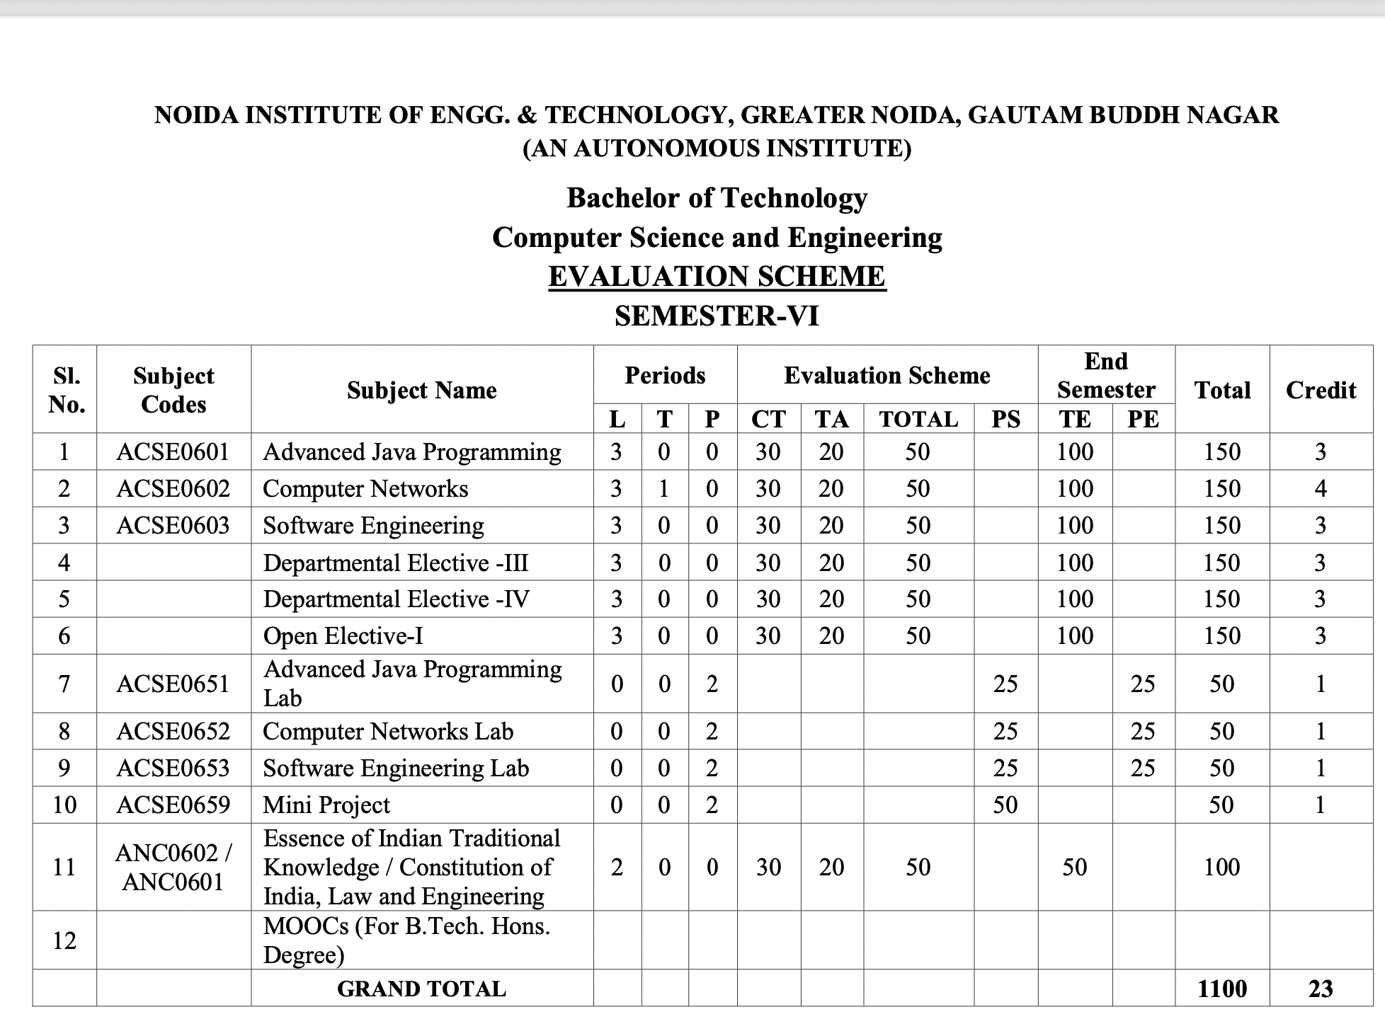
Evaluation Scheme

Slide 5
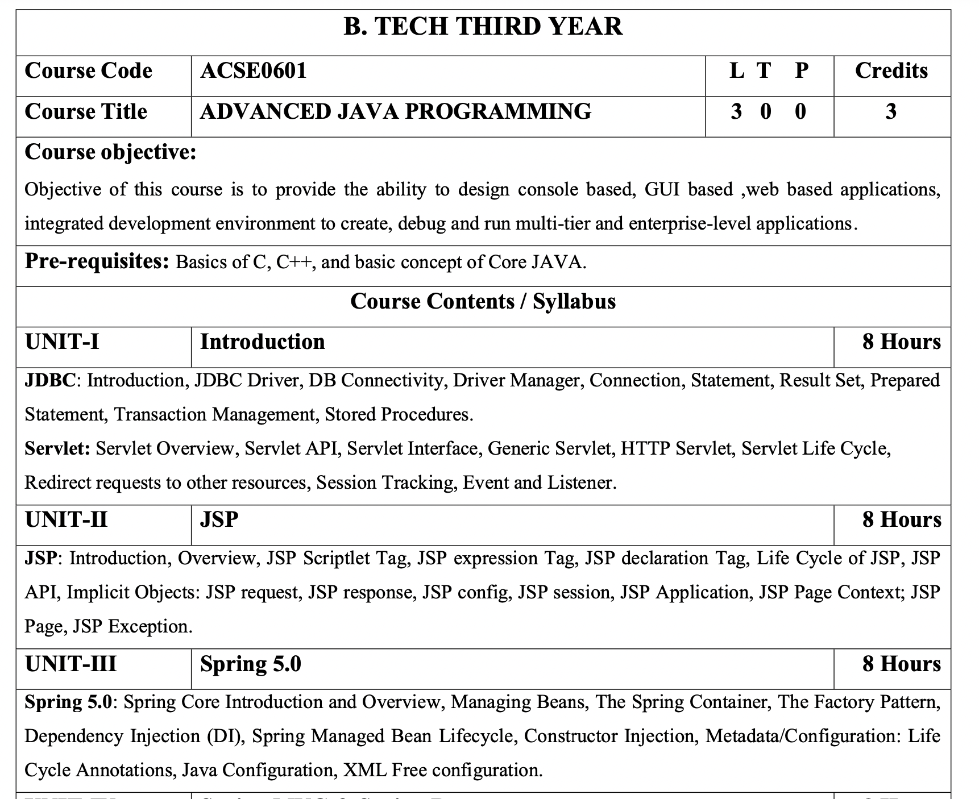
Syllabus

Slide 6
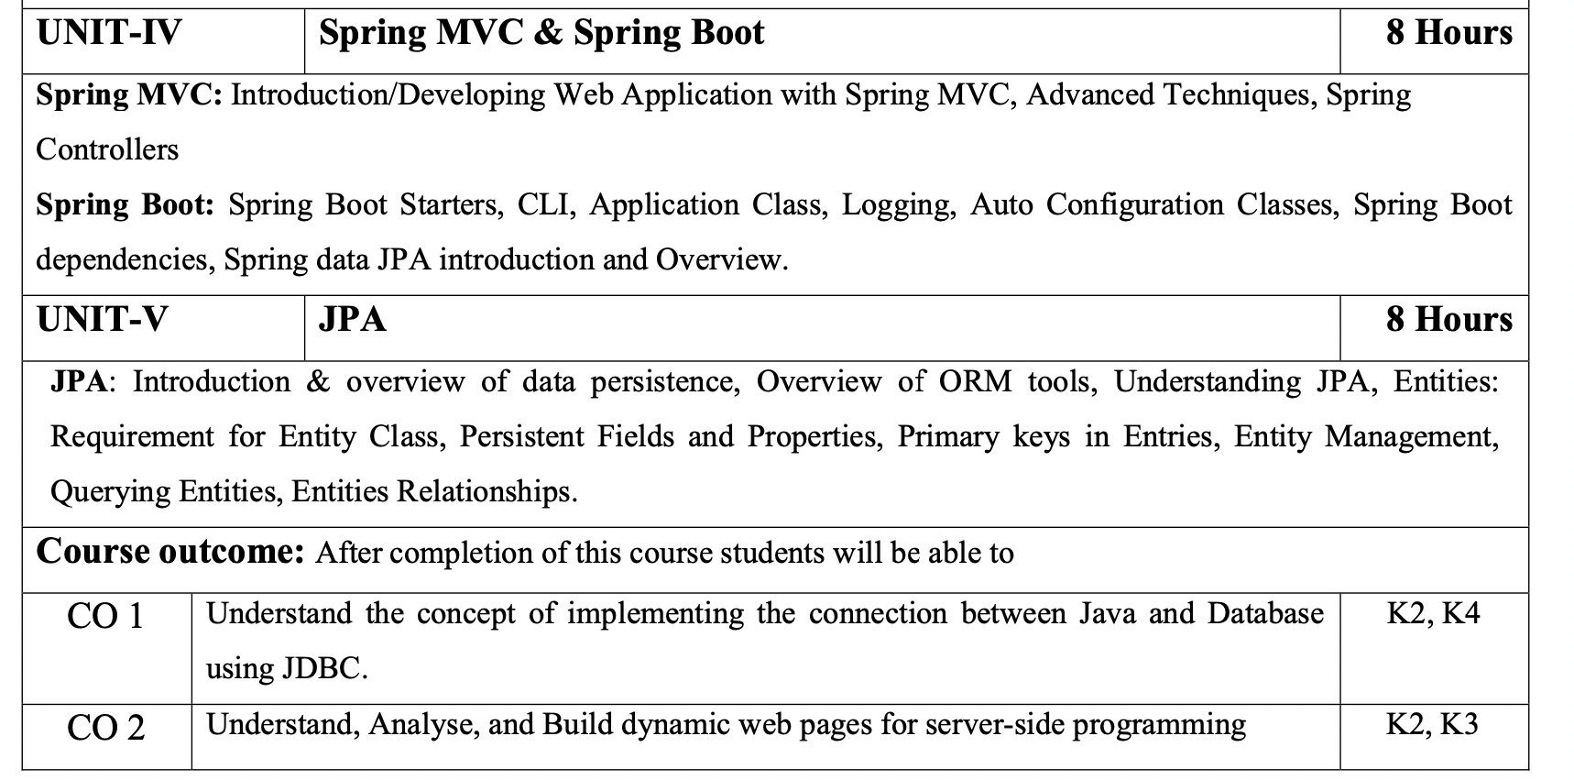
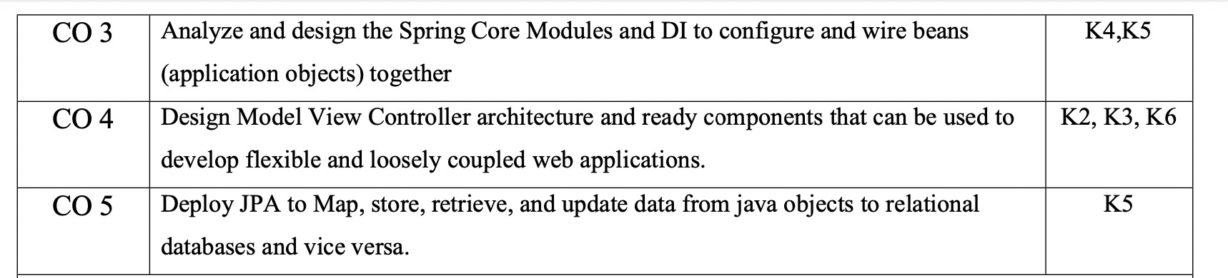
Syllabus

Slide 7
Content
JSP: Introduction
Overview
JSP Scriptlet Tag
JSP expression Tag
JSP declaration Tag
Life Cycle of JSP
JSP API
Implicit Objects: JSP request
JSP response
JSP config
JSP session
JSP Application
JSP Page Context
JSP Page
JSP Exception

Slide 8
Course Objective
Objective of this course is to provide the ability to design console based, GUI based ,web based applications, integrated development environment to create, debug and run multi-tier and enterprise-level applications.

Slide 9
Course Outcome
After completion of this course, students will be able to-
CO1: Understand the concept of implementing the connection between Java and Database using JDBC.
CO2: Understand, Analyse, and Build dynamic web pages for server-side programming
CO3: Analyze and design the Spring Core Modules and DI to configure and wire beans (application objects) together
CO4: Design Model View Controller architecture and ready components that can be used to develop flexible and loosely coupled web applications.
CO5: Deploy JPA to Map, store, retrieve, and update data from java objects to relational databases and vice versa.

Slide 10
Program Outcomes (POs)
Engineering Graduates will be able to:
PO1 : Engineering Knowledge
PO2 : Problem Analysis
PO3 : Design/Development of solutions
PO4 : Conduct Investigations of complex problems
PO5 : Modern tool usage
PO6 : The engineer and society

Slide 11
Program Outcomes (POs) cont…
Engineering Graduates will be able to:
PO7 : Environment and sustainability
PO8 : Ethics
PO9 : Individual and teamwork
PO10 : Communication
PO11 : Project management and finance
PO12 : Life-long learning

Slide 12
CO – PO and PSO Mapping
Design Thinking
CO.K | PO1 | PO2 | PO3 | PO4 | PO5 | PO6 | PO7 | PO8 | PO9 | PO10 | PO11 | PO12
ACSE0601.1 | 3 | 3 | 3 | 3 | 2 | - | - | - | 2 | 2 | - | 3
ACSE0601.2 | 3 | 3 | 3 | 3 | 2 | 2 | - | 1 | 1 | 1 | - | 3
ACSE0601.3 | 3 | 3 | 2 | 3 | 3 | 2 | - | 2 | 1 | 1 | 2 | 3
ACSE0601.4 | 3 | 3 | 3 | 3 | 2 | 2 | - | 2 | 2 | 1 | 3 | 3
ACSE0601.5 | 2 | 2 | 2 | 2 | 2 | 2 | - | 2 | 1 | 1 | 1 | 2
Average | 2.8 | 2.8 | 2.6 | 2.8 | 2.2 | 1.6 | - | 1.8 | 1.4 | 1.2 | 1.2 | 2.8

Slide 13
Program Educational Objectives (PEOs)
Program Educational Objectives (PEOs) | PEOs Description
PEOs | To have an excellent scientific and engineering breadth so as to comprehend, analyze, design and provide sustainable solutions for real-life problems using state-of-the-art technologies.
PEOs | To have a successful career in industries, to pursue higher studies or to support entrepreneurial endeavors and to face the global challenges.
PEOs | To have an effective communication skills, professional attitude, ethical values and a desire to learn specific knowledge in emerging trends, technologies for research, innovation and product development and contribution to society.
PEOs | To have life-long learning for up-skilling and re-skilling for successful professional career as engineer, scientist, entrepreneur and bureaucrat for betterment of society.

Slide 14
Result Analysis
Section Wise Result
IT A- 100%
IT B- 100%
IT C- 98.5%

Slide 15
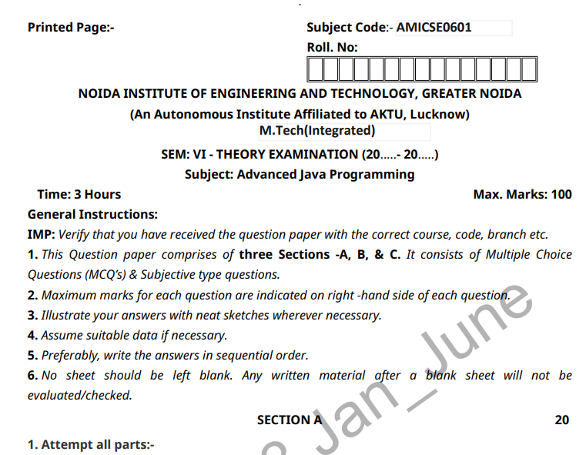
End Semester Question Paper Templates (Offline Pattern/Online Pattern

Slide 16
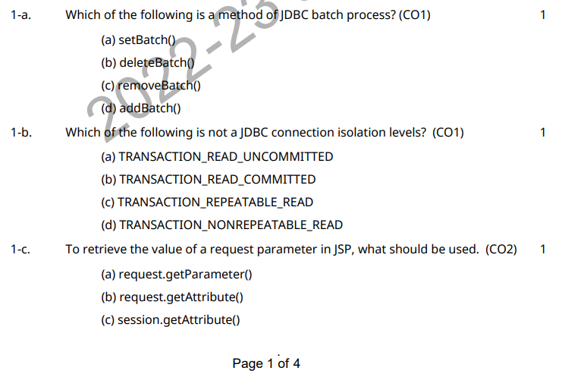
End Semester Question Paper Templates (Offline Pattern/Online Pattern

Slide 17
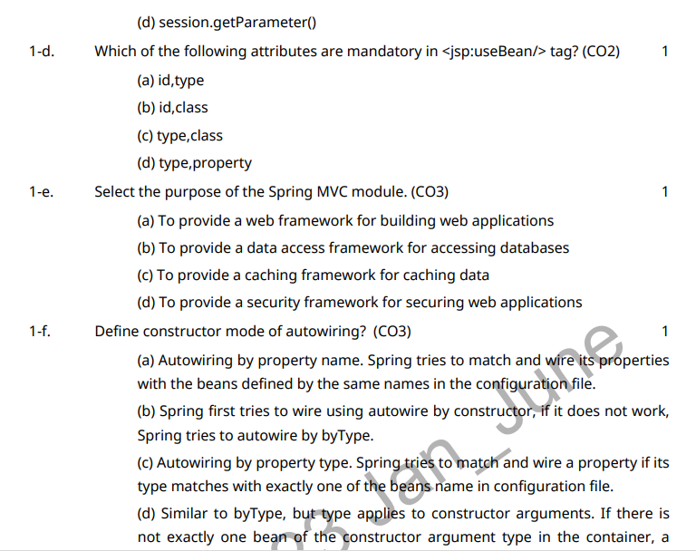
End Semester Question Paper Templates (Offline Pattern/Online Pattern

Slide 18
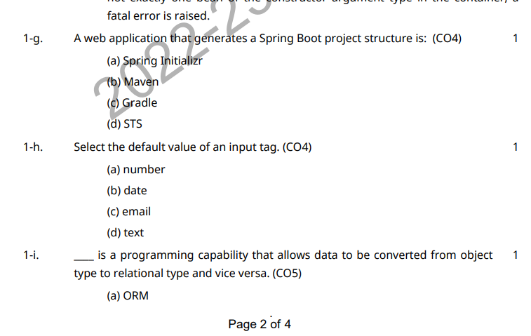
End Semester Question Paper Templates (Offline Pattern/Online Pattern

Slide 19
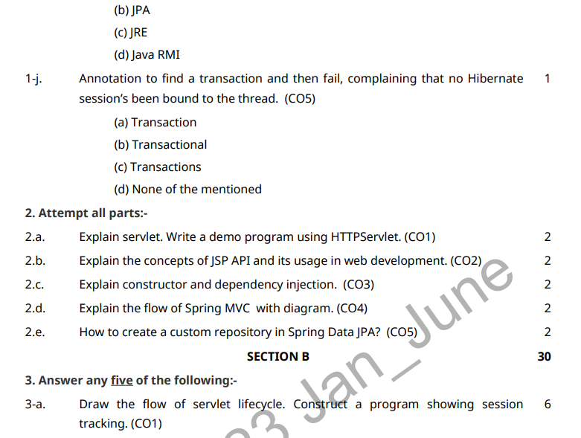
End Semester Question Paper Templates (Offline Pattern/Online Pattern

Slide 20
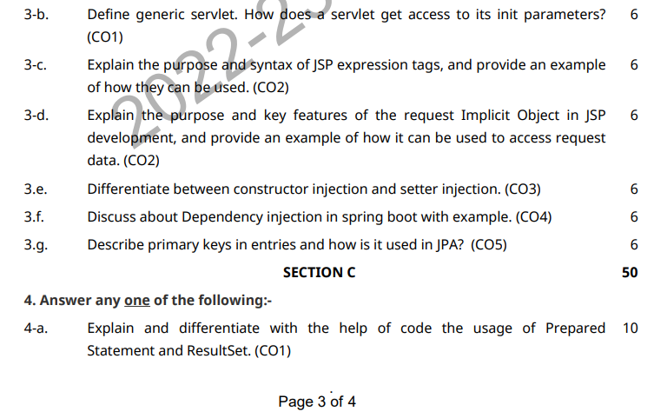
End Semester Question Paper Templates (Offline Pattern/Online Pattern

Slide 21
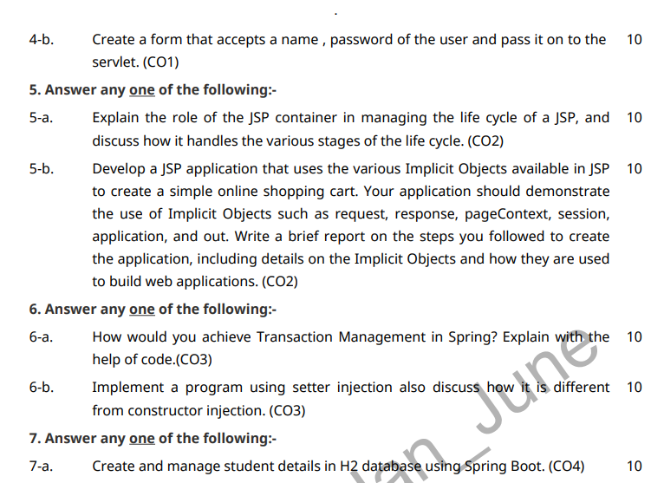
End Semester Question Paper Templates (Offline Pattern/Online Pattern

Slide 22
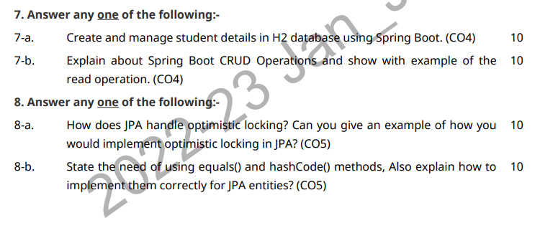
End Semester Question Paper Templates (Offline Pattern/Online Pattern

Slide 23
End Semester Question Paper Template
B TECH
(SEM-V) THEORY EXAMINATION 20__-20__
COMPILER DESIGN
Time: 3 Hours Total Marks: 100
Note: 1. Attempt all Sections. If require any missing data; then choose suitably.
SECTION A
Attempt all questions in brief. 2 x 10 = 20
Q.No. | Question | Marks | CO
1 |  | 2
2 |  | 2
. |  | .
10 |  | 2
Surbhi Jha ACSE0601 Unit-II

Slide 24
End Semester Question Paper Templates
SECTION B
2. Attempt any three of the following: 3 x 10 = 30
SECTION C
3. Attempt any one part of the following: 1 x 10 = 10
Q.No. | Question | Marks | CO
1 |  | 10
2 |  | 10
. |  | .
5 |  | 10
Q.No. | Question | Marks | CO
1 |  | 10
2 |  | 10
Surbhi Jha ACSE0601 Unit-II

Slide 25
Prerequisite
Pre-requisites: Basics of C, C++, and basic concept of Core JAVA.

Slide 26
Recap
Recap:
Previous concept was focused on object oriented programming.
The main concepts has been discussed about core java functionalities
In core java we have discussed about class,interface,exception handling, multi-threading etc.

Slide 27
Brief Introduction about the subject with videos
Advanced Java is everything that goes beyond Core Java – most importantly the APIs defined in Java Enterprise Edition, includes Servlet programming, Web Services, the Persistence API, etc. It is a Web & Enterprise application development platform which basically follows client & server architecture.
https://youtu.be/vHmUVQKXlVo
https://youtu.be/qz0aGYrrlhU

Slide 28
Unit Objective
.
To get detailed insights of JSP.

Slide 29

Topic Objective
JDBC: Introduction, JDBC Driver, DB Connectivity, Driver Manager, Connection, Statement, Result Set, Prepared Statement, Transaction Management, Stored Procedures. Servlet: Servlet Overview, Servlet API, Servlet Interface, Generic Servlet, HTTP Servlet, Servlet Life Cycle, Redirect requests to other resources, Session Tracking, Event and Listener. | It provides universal data access from the Java programming language.
JSP: Introduction, Overview, JSP Scriptlet Tag, JSP expression Tag, JSP declaration Tag, Life Cycle of JSP, JSP API, Implicit Objects: JSP request, JSP response, JSP config, JSP session, JSP Application, JSP Page Context; JSP Page, JSP Exception. | To learn creating web application.
Spring 5.0: Spring Core Introduction and Overview, Managing Beans, The Spring Container, The Factory Pattern, Dependency Injection (DI), Spring Managed Bean Lifecycle, Constructor Injection, Metadata/Configuration: Life Cycle Annotations, Java Configuration, XML Free configuration. | To understand Java framework which is used to build web applications.

Slide 30
Topic Objective
Spring MVC: Introduction/Developing Web Application with Spring MVC, Advanced Techniques, Spring Controllers Spring Boot: Spring Boot Starters, CLI, Application Class, Logging, Auto Configuration Classes, Spring Boot dependencies, Spring data JPA introduction and Overview. | To learn design pattern that separates the business logic, presentation logic and data.
JPA: Introduction & overview of data persistence, Overview of ORM tools, Understanding JPA, Entities: Requirement for Entity Class, Persistent Fields and Properties, Primary keys in Entries, Entity Management, Querying Entities, Entities Relationships. | To learn how we can examine, control, and persist data between Java objects and relational databases.

Slide 31
JSP Introduction(CO2)
It stands for Java Server Pages.
It is a server side technology.
It is used for creating web application.
It is used to create dynamic web content.
In this JSP tags are used to insert JAVA code into HTML pages.
It is an advanced version of Servlet Technology.
It is a Web based technology helps us to create dynamic and platform independent web pages.
In this, Java code can be inserted in HTML/ XML pages or both.
JSP is first converted into servlet by JSP container before processing the client’s request.

Slide 32
Features of JSP(CO2)
Coding in JSP is easy :- As it is just adding JAVA code to HTML/XML.
Reduction in the length of Code :- In JSP we use action tags, custom tags etc.
Connection to Database is easier :-It is easier to connect website to database and allows to read or write data easily to the database.
Make Interactive websites :- In this we can create dynamic web pages which helps user to interact in real time environment.
Portable, Powerful, flexible and easy to maintain :- as these are browser and server independent.
No Redeployment and No Re-Compilation :- It is dynamic, secure and platform independent so no need to re-compilation.
Extension to Servlet :- as it has all features of servlets, implicit objects and custom tags

Slide 33
Advantages of JSP (CO2)
Here is the list of benefits that JSP provides:
JSP codes are easy to write and maintain.
Development speed becomes fast, and there is no need for recompilation and redeployment.
It has high performance and scalability compared to other dynamic web development tools.
JSP is constructed on Java technology, which makes it platform-independent.

Slide 34
Disadvantages of JSP (CO2)
Difficult to debug for errors.
First time access leads to wastage of time
It’s output is HTML which lacks features.

Slide 35
JSP Overview(CO2)
JavaServer Pages (JSP) is a Sun Microsystems specification for combining Java with HTML to provide dynamic content for Web pages. When you create dynamic content, JSPs are more convenient to write than HTTP servlets because they allow you to embed Java code directly into your HTML pages, in contrast with HTTP servlets, in which you embed HTML inside Java code. JSP is part of the Java 2 Enterprise Edition (J2EE).

Slide 36
JSP Overview(CO2)
JSP enables you to separate the dynamic content of a Web page from its presentation. It caters to two different types of developers: HTML developers, who are responsible for the graphical design of the page, and Java developers, who handle the development of software to create the dynamic content.
Because JSP is part of the J2EE standard, you can deploy JSPs on a variety of platforms, including WebLogic Server. In addition, third-party vendors and application developers can provide JavaBean components and define custom JSP tags that can be referenced from a JSP page to provide dynamic content.

Slide 37
How JSP Requests Are Handled(CO1)
WebLogic Server handles JSP requests in the following sequence:
A browser requests a page with a .jsp file extension from WebLogic Server.
WebLogic Server reads the request.
Using the JSP compiler, WebLogic Server converts the JSP into a servlet class that implements the javax.servlet.jsp.JspPage interface. The JSP file is compiled only when the page is first requested, or when the JSP file has been changed. Otherwise, the previously compiled JSP servlet class is re-used, making subsequent responses much quicker.
The generated JspPage servlet class is invoked to handle the browser request.

Slide 38
JSP Scriptlet tag (Scripting elements) (CO1) Cont
In JSP, java code can be written inside the jsp page using the scriptlet tag. Let's see what are the scripting elements first.
JSP Scripting elements
The scripting elements provides the ability to insert java code inside the jsp. There are three types of scripting elements:
scriptlet tag
expression tag
declaration tag

Slide 39
JSP Scriplet Tag(CO2)
A scriptlet tag is used to execute java source code in JSP.
Syntax is as follows:
<% java code %>

Slide 40
Example of JSP Scriplet Tag Cont…(CO2)
In this example, we have created two files index.html and welcome.jsp. The index.html file gets the username from the user and the welcome.jsp file prints the username with the welcome message.
index.html
<html>
<body>
<form action="welcome.jsp">
<input type="text" name="uname">
<input type="submit" value="go"><br/>
</form>
</body>
</html>
welcome.jsp
<html>
<body>
<%
String name=request.getParameter("uname");
out.print("welcome "+name);
%>
</form>
</body>
</html>

Slide 41
JSP expression Tag(CO2)
The code placed within JSP expression tag is written to the output stream of the response. So you need not write out.print() to write data. It is mainly used to print the values of variable or method.
Syntax of JSP expression tag:
<%= statement %>
Example of JSP expression tag that prints the user name
In this example, we are printing the username using the expression tag. The index.html file gets the username and sends the request to the welcome.jsp file, which displays the username.

Slide 42
Example of JSP expression tag that prints the user name (CO2)
index.jsp
<html>
<body>
<form action="welcome.jsp">
<input type="text" name="uname"><br/>
<input type="submit" value="go">
</form>
</body>
</html>
welcome.jsp
<html>
<body>
<%= "Welcome "+request.getParameter("uname") %>
</body>
</html>

Slide 43
JSP declaration Tag(CO2)
The JSP declaration tag is used to declare fields and methods.
The code written inside the jsp declaration tag is placed outside the service() method of auto generated servlet.
So it doesn't get memory at each request.
Syntax of JSP declaration tag
<%! field or method declaration %>

Slide 44
Example of declaration Tag that declares field(CO2)
In this example of JSP declaration tag, we are declaring the field and printing the value of the declared field using the jsp expression tag.
Index.jsp
<html>
<body>
<%! int data=50; %>
<%= "Value of the variable is:"+data %>
</body>
</html>

Slide 45
Example of declaration Tag that declares method(CO2)
In this example of JSP declaration tag, we are defining the method which returns the cube of given number and calling this method from the jsp expression tag. But we can also use jsp scriptlet tag to call the declared method.
index.jsp
<html>
<body>
<%!
int cube(int n){
return n*n*n*;
}
%>
<%= "Cube of 3 is:"+cube(3) %>
</body>
</html>

Slide 46
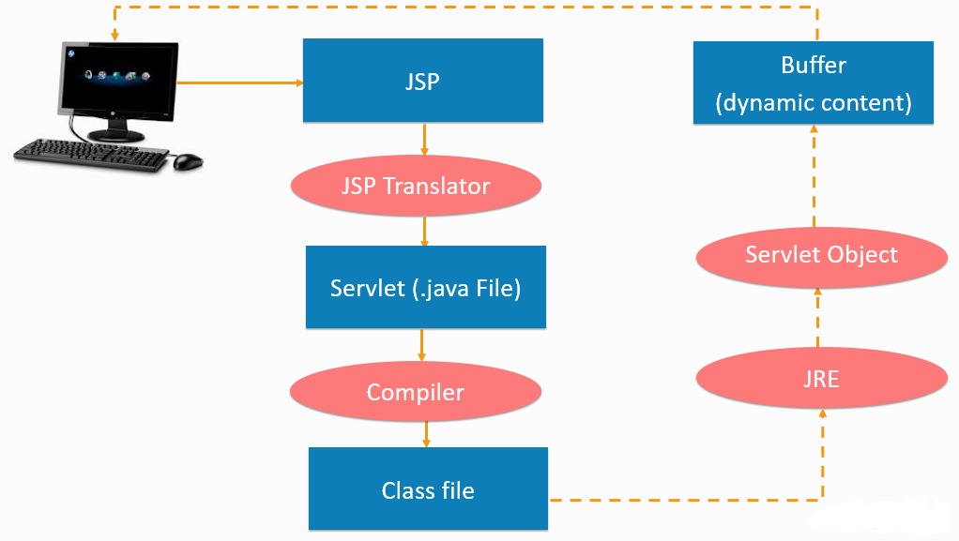
Life Cycle of JSP Page(CO2)

Slide 47
Lifecycle of JSP Cont… (CO2)
1. JSP page translation: A Java servlet file is created from the JSP source file. In the translation phase, the container validates the correctness of the JSP pages and tag files.
2. JSP page compilation: The created java servlet file is compiled into a Java servlet class.
3. Class loading: The java servlet class that was compiled from the JSP source is now loaded into the container.
4. Execution phase: In the execution phase, the container creates one or more instances of this class in response to the requests. The interface JsP Page contains jspInit() and jspDestroy(). JSP provides special interface HttpJspPage for JSP pages specifically for the HTTP requests and this interface contains _jspService().
5. Initialization: jspInit() method is called immediately after the instance is created.
6. jspDestroy() execution: This method is called when JSP is destroyed. With this call, the servlet completes its purpose and goes into the garbage collection This ends the JSP life cycle.
There are certain life cycle methods provided in JSP, these are: jspInit(), _jspService() and jspDestroy(), explained above.
Learning about the lifecycle is important. It gives you an insight into the actual functioning. Now, let us see and understand the syntax used in creating a JSP page.

Slide 48
Difference between JSP Scriptlet tag and Declaration tag (CO2)
Jsp Scriptlet Tag | Jsp Declaration Tag
The jsp scriptlet tag can only declare variables not methods. | The jsp declaration tag can declare variables as well as methods.
The declaration of scriptlet tag is placed inside the _jspService() method. | The declaration of jsp declaration tag is placed outside the _jspService() method.

Slide 49
Daily Quiz
Which page directive should be used in JSP to generate a PDF page? a) contentType b) generatePdf c) typePDF d) contentPDF
Which tag should be used to pass information from JSP to included JSP? a) Using <%jsp:page> tag b) Using <%jsp:param> tag c) Using <%jsp:import> tag d) Using <%jsp:useBean> tag
Application is instance of which class? a) javax.servlet.Application b) javax.servlet.HttpContext c) javax.servlet.Context d) javax.servlet.ServletContext

Slide 50
Daily Quiz
4. In JSP, which directive is used to import Java packages or classes into a JSP page?
<jsp:useBean>
b) <jsp:directive.page>
c) <%@ page import %>
d) <jsp:include>
5. Which implicit object in JSP represents the client's requested information?
a) request
b) response
c) out
d) Session
6. Which JSP action is used to include the contents of another resource during the JSP page processing?
a) <jsp:include>
b) <jsp:forward>
c) <jsp:useBean>
d) <jsp:setProperty>

Slide 51
Daily Quiz
5. In JSP, which tag is used to iterate over a collection or array of objects?
a) <c:choose>
b) <c:forEach>
c) <c:if>
d) <c:set>
What is the correct syntax for declaring and initializing a variable in JSP?
a) <% int x = 10; %>
b) <%! int x = 10; %>
c) <% int x; x = 10; %>
d) <% int x; x := 10; %>
What is the default scope of JSP variables?
a) Request scope
b) Session scope
c) Application scope
d) Page scope

Slide 52
Weekly Assignment
Discuss the concept of JSP.
Explain JSP Scriplet Tag.
Illustrate JSP expression Tag.
Summarize JSP declaration Tag.
What do you understand by life cycle of JSP?

Slide 53
JSP API (CO2)
JSP API is a set of classes and interfaces that can be used to make a JSP page. These classes and interfaces are contained in the javax servlet.jsp packages. A portion of the classes characterized in the javax. servlet.jsp packages are:
Error Data
JSP Writer
Page Context
The Error Data Class: The error information class characterizes error data for error pages. You have to set the estimation of the page mandate, isErrorPage to be consistent with demonstrating that a page is an error page. The error information class expands the java.lang.Object class. A portion of the strategies characterized in the ErrorData that you can use in a JSP page is: .

Slide 54
JSP API (CO2)
getRequestURL(): Returns the mentioned URL through String.
getServletName(): Returns the name of the servlet conjured through String.
getStatusCode(): Returns the status code of the blunder as a whole number.
getThrowable(): Returns the Throwable special case that caused the mistake.

Slide 55
JSP API Cont…(CO2)
The JspWriter Class: In a JSP page to compose activity and layout information we can utilize JSPWriter class. The understood variable out gives the JSPWriter class object. The JSPWriter class broadens the java.io.Writer class. A portion of the techniques characterize in the JSPWriter class that you can use in a JSP page are:
clear(): Clears the substance of the cradle. The reasonable() technique tosses an IOException special case if the support is now cleared.
close(): Closes and flushes the stream.
flush(): Flushes the cradle stream. The flush() strategy flushes every one of the cradles in a chain of Writers and OutputStream. It tosses java.io.IOException special case on the off chance that you make a call to the compose() or flush() in the wake of shutting the stream.
getBufferSize(): Return the size of the support utilized by the JSPWriter.

Slide 56
JSP API Cont…(CO2)
4. print(): Prints the estimation of sort boolean, integer, character, long whole number, coasting point, twofold exactness gliding – point number, a variety of character, string, and item. The print() tosses the java.io.IOException exemption if any blunder happens while printing.
5. println(): Prints an estimation of sort boolean, whole number, character, long whole number, drifting point, twofold exactness coasting point number, a variety of character, string, and article. The Println() tosses the java.io.IOException exemption if any blunder happens while printing.

Slide 57
JSP API Cont…(CO2)
The PageContext Class: The setting data is given by the PageContext class when the JSP innovation is utilized in the servlet condition. The PageContext class expands the JSPContext class. A PageContext occasion furnishes access to namespaces related to the JSP page. Some of the strategies characterized in the PageContext class are:
forward(): Redirects the current servlet demand and servlet reaction to another page. This strategy acknowledges the URL of an objective page as a contention.
getPage(): Returns the present estimation of the page object.
getRequest(): Returns the present estimation of the solicitation object. The servlet solicitation is the arrival kind of getRequest().
getResponse(): Returns the present estimation of the reaction object. The return kind of the getResponse() technique is the servlet reaction.
getServletConfig(): Returns the ServletConfig of the present page.

Slide 58
JSP API Cont…(CO2)
6. getServletContext(): Returns the ServletContext of the present page.
7. getSession(): The arrival kind of getSession() is HttpSession. It will restore the current PageContext.
8. include(): Processes the current servlet demand and the reaction determined in the URL. The incorporate() technique accepts two contentions, a URL way and the flush estimation of boolean sort.

Slide 59
Session Tracking in JSP (CO2)
Cookies: A little message field put away on the customers machine. The treat can be impair in the program settings so they are not constantly accessible.
URL revamping: Store session data in the URL. Works, when treats are not bolstered yet, can make bookmarking of site pages an issue since they have session explicit data toward the finish of a URL.
Avoided fields: HTML covered up alter boxes, for example:
<input type = "hidden">
Session objects: JSP Implicit Object. A session article utilizes a key/esteem mix to store information. To retrieve data from a session:
session.getValued("msg")
The arrival kind of the strategy getValue is Object, so you should typecase to get the required worth. Invalid is returned when there is no such key with the session name.

Slide 60
Implicit Objects: JSP request(CO2)
The JSP request is an implicit object of type HttpServletRequest i.e. created for each jsp request by the web container. It can be used to get request information such as parameter, header information, remote address, server name, server port, content type, character encoding etc.
It can also be used to set, get and remove attributes from the jsp request scope.
Let's see the simple example of request implicit object where we are printing the name of the user with welcome message.
Example of JSP request implicit object
Index.html
<form action="welcome.jsp">
<input type="text" name="uname">
<input type="submit" value="go"><br/>
</form>

Slide 61
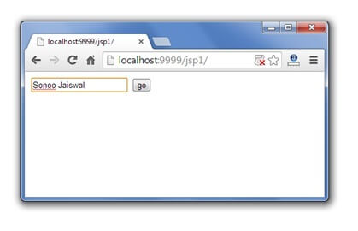
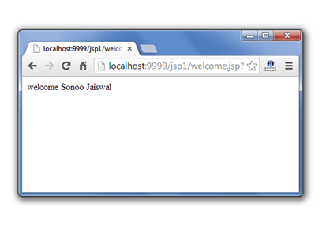
Example of JSP request implicit object Cont…(CO2)
welcome.jsp
<%
String name=request.getParameter("uname");
out.print("welcome "+name);
%>

Slide 62
JSP response implicit object (CO2)
In JSP, response is an implicit object of type HttpServletResponse. The instance of HttpServletResponse is created by the web container for each jsp request.
It can be used to add or manipulate response such as redirect response to another resource, send error etc.
Let's see the example of response implicit object where we are redirecting the response to the Google.

Slide 63
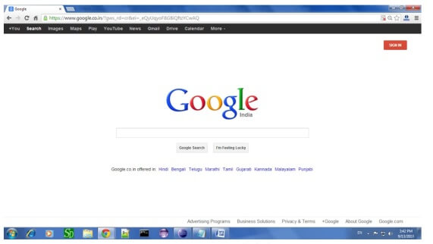
Example of response implicit object (CO2)
index.html
<form action="welcome.jsp">
<input type="text" name="uname">
<input type="submit" value="go"><br/>
</form>
welcome.jsp
<%
response.sendRedirect("http://www.google.com");
%>

Slide 64
JSP Config Implicit Object(CO2)
In JSP, config is an implicit object of type ServletConfig. This object can be used to get initialization parameter for a particular JSP page. The config object is created by the web container for each jsp page. SP’s config object carries the configuration pieces of information like the username, password, driver name, servlet name, servlet context, specification names, and their values settle in the web.xml (configuration file).
Generally, it is used to get initialization parameter from the web.xml file.
Example of config implicit object
index.html
<form action="welcome">
<input type="text" name="uname">
<input type="submit" value="go"><br/>
</form>

Slide 65
Example of config implicit object Cont…(CO2)
web.xml file
<web-app>
<servlet>
<servlet-name>sonoojaiswal</servlet-name>
<jsp-file>/welcome.jsp</jsp-file>
<init-param>
<param-name>dname</param-name>
<param-value>sun.jdbc.odbc.JdbcOdbcDriver</param-value>
</init-param>
</servlet>
<servlet-mapping>
<servlet-name>sonoojaiswal</servlet-name>
<url-pattern>/welcome</url-pattern>
</servlet-mapping>
</web-app>
welcome.jsp
<%
out.print("Welcome "+request.getParameter("uname"));
String driver=config.getInitParameter("dname");
out.print("driver name is="+driver);
%>

Slide 66
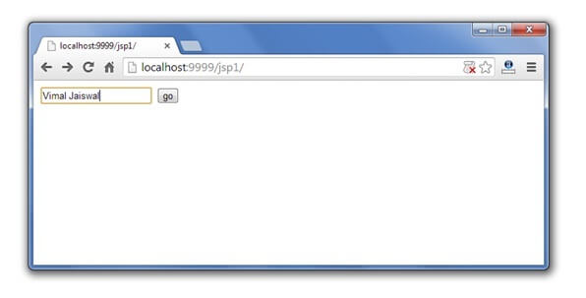
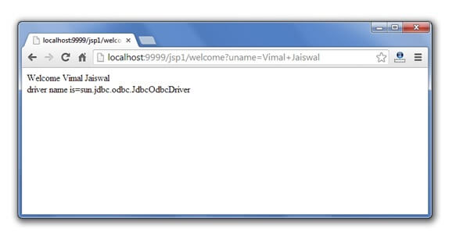
JSP COnfig implicit object Output(CO2)

Slide 67
JSP Session(CO2)
In JSP, session is an implicit object of type HttpSession.The Java developer can use this object to set,get or remove attribute or to get session information. It is mainly used to approach all data of the user until the user session is active
Example of session implicit object
index.html
<html>
<body>
<form action="welcome.jsp">
<input type="text" name="uname">
<input type="submit" value="go"><br/>
</form>
</body>
</html>

Slide 68
Example of session implicit object (CO2)
welcome.jsp
<html>
<body>
<%
String name=request.getParameter("uname");
out.print("Welcome "+name);
session.setAttribute("user",name);
<a href="second.jsp">second jsp page</a>
%>
</body>
</html>
second.jsp
<html>
<body>
<%
String name=(String)session.getAttribute("user");
out.print("Hello "+name);
%>
</body>
</html>

Slide 69
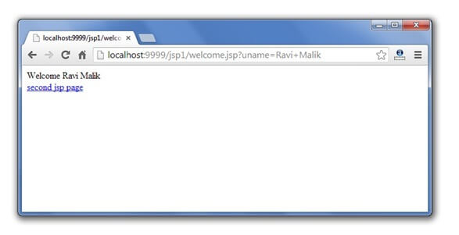
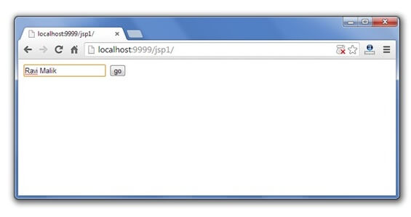
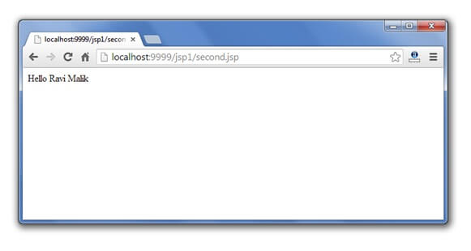
Session Implicit Object Output (CO2)

Slide 70
JSP Application (CO2)
In JSP, application is an implicit object of type ServletContext.
The instance of ServletContext is created only once by the web container when application or project is deployed on the server.
This object can be used to get initialization parameter from configuaration file (web.xml). It can also be used to get, set or remove attribute from the application scope.
This initialization parameter can be used by all jsp pages.

Slide 71
Example of application implicit object (CO2)
web.xml file
<web-app>
<servlet>
<servlet-name>sonoojaiswal</servlet-name>
<jsp-file>/welcome.jsp</jsp-file>
</servlet>
<servlet-mapping>
<servlet-name>sonoojaiswal</servlet-name>
<url-pattern>/welcome</url-pattern>
</servlet-mapping>
<context-param>
<param-name>dname</param-name>
<param-value>sun.jdbc.odbc.JdbcOdbcDriver</param-value>
</context-param>
</web-app>
index.html
<form action="welcome">
<input type="text" name="uname">
<input type="submit" value="go"><br/>
</form>

Slide 72
Example of application implicit object Cont…(CO2)
welcome.jsp
<%
out.print("Welcome "+request.getParameter("uname"));
String driver=application.getInitParameter("dname");
out.print("driver name is="+driver);
%>

Slide 73
Output of application implicit object Cont…(CO2)

Slide 74
Daily Quiz
_jspService() method of HttpJspPage class should not be overridden. a) True b) False
Which option is true about session scope? a) Objects are accessible only from the page in which they are created b) Objects are accessible only from the pages which are in same session c) Objects are accessible only from the pages which are processing the same request d) Objects are accessible only from the pages which reside in same application
Which one is the correct order of phases in JSP life cycle? a) Initialization, Cleanup, Compilation, Execution b) Initialization, Compilation, Cleanup, Execution c) Compilation, Initialization, Execution, Cleanup d) Cleanup, Compilation, Initialization, Execution

Slide 75
Daily Quiz
4. What is the correct signature of jspInit() method of HttpJspPage class?
A - void jspInit(HTTPRequest request, HTTPResponse response)
B - void jspInit(HTTPRequest request, HTTPResponse response) throws ServletException, IOException
C - void jspInit()
D - void jspInit() throws ServletException, IOException
5. Which of the following is a server side technology?
A - html
B - jsp
C - javaScript
D - css
6. Which is the methods of generated Servlet?
A - jspInit()
B - _jspService()
C - jspDestroy()
D - All of the above

Slide 76
Daily Quiz
7. Which of the following attribute is used to mark a page as error processing page?
A - isErrorPage
B - errorPage
C - exception
D - exceptionPage
8. Which of the following method can be used to read parameters names?
A - request.getParameter()
B - response.getParameter()
C - request.getParameterNames()
D - response.getParameterNames()
9. Is it possible to include files using absolute path in a JSP page using include directive?
A - true
B - false

Slide 77
Page Context implicit object (CO2)
JSP, page Context is an implicit object of type Page Context class. The page Context object can be used to set,get or remove attribute from one of the following scopes: page request session application
In JSP, page scope is the default scope.

Slide 78
Example of page Context implicit object (CO2)
second.jsp
<html>
<body>
<%
String name=(String)pageContext.getAttribute("user",PageContext.SESSION_SCOPE);
out.print("Hello "+name);
%>
</body>
</html>
index.html
<html>
<body>
<form action="welcome.jsp">
<input type="text" name="uname">
<input type="submit" value="go"><br/>
</form>
</body>
</html>
welcome.jsp
<html>
<body>
<%
String name=request.getParameter("uname");
out.print("Welcome "+name);
pageContext.setAttribute("user",name,PageContext.SESSION_SCOPE);
<a href="second.jsp">second jsp page</a>
%>
</body>
</html>

Slide 79
Output of page Context implicit object (CO2)

Slide 80
JSP Page (CO2)
A JSP page is a text document that contains two types of text: static data, which can be expressed in any text-based format (such as HTML, SVG, WML, and XML), and JSP elements, which construct dynamic content.
The recommended file extension for the source file of a JSP page is .jsp. The page can be composed of a top file that includes other files that contain either a complete JSP page or a fragment of a JSP page. The recommended extension for the source file of a fragment of a JSP page is .jspf.
The JSP elements in a JSP page can be expressed in two syntaxes, standard and XML, though any given file can use only one syntax. A JSP page in XML syntax is an XML document and can be manipulated by tools and APIs for XML documents.

Slide 81
Creating a simple JSP Page (CO2)
To create the first JSP page, write some HTML code as given below, and save it by .jsp extension. We have saved this file as index.jsp. Put it in a folder and paste the folder in the web-apps directory in apache tomcat to run the JSP page.
index.jsp
Let's see the simple example of JSP where we are using the scriptlet tag to put Java code in the JSP page. We will learn scriptlet tag later.
<html>
<body>
<% out.print(2*5); %>
</body>
</html>
It will print 10 on the browser.

Slide 82
JSP Exception (CO2)
Exceptions in JSP occur when there is an error in the code either by the developer or internal error from the system. Exception handling in JSP is the same as in Java where we manage exceptions using Try Catch blocks. Unlike Java, there are exceptions in JSP also when there is no error in the code.
Types of Exceptions in JSP
Exceptions in JSP are of three types:
Checked Exception
Runtime Exception
Error Exception

Slide 83
JSP Exception (CO2)
index.jsp
<form action="process.jsp">
No1:<input type="text" name="n1" /><br/><br/>
No1:<input type="text" name="n2" /><br/><br/>
<input type="submit" value="divide"/>
</form>
process.jsp
<%@ page errorPage="error.jsp" %>
<%
String num1=request.getParameter("n1");
String num2=request.getParameter("n2");
int a=Integer.parseInt(num1);
int b=Integer.parseInt(num2);
int c=a/b;
out.print("division of numbers is: "+c);
%>

Slide 84
JSP Exception (CO2)
error.jsp
<%@ page isErrorPage="true" %>
<h3>Sorry an exception occured!</h3>
Exception is: <%= exception %>

Slide 85
Checked Exceptions (CO2)
It is normally a user error or problems which are not seen by the developer are termed as checked exceptions.
Some Checked exception examples are:
FileNotFoundException: This is a checked exception (where it tries to find a file when the file is not found on the disk).
IO Exception: This is also checked exception if there is any exception occurred during reading or writing of a file then the IO exception is raised.
SQLException: This is also a checked exception when the file is connected with SQL database, and there is issue with the connectivity of the SQL database then SQLException is raised

Slide 86
Runtime Exceptions (CO2)
Runtime exceptions are the one which could have avoided by the programmer. They are ignored at the time of compilation.
Some Runtime exception examples are:
ArrayIndexOutOfBoundsException: This is a runtime exception when array size exceeds the elements.
ArithmeticException: This is also a runtime exception when there are any mathematical operations, which are not permitted under normal conditions, for example, dividing a number by 0 will give an exception.
NullPointer Exception: This is also a runtime exception which is raised when a variable or an object is null when we try to access the same. This is a very common exception.

Slide 87
Errors (CO2)
The problem arises due to the control of the user or programmer. If stack overflows, then error can occur.
Some examples of the error are listed below:
Error: This error is a subclass of throwable which indicates serious problems that an application cannot catch.
Instantiation Error: This error occurs when we try to instantiate an object, and it fails to do that.
Internal Error: This error occurs when there is an error occurred from JVM i.e. Java Virtual Machine.

Slide 88
Error Exceptions(CO2)
It is an instance of the throwable class, and it is used in error pages.
Some methods of throwable class are:
Public String getMessage() – returns the message of the exception.
Public throwablegetCause() – returns cause of the exception
Public printStackTrace()– returns the stacktrace of the exception.

Slide 89
Weekly Assignment
How we can apply JSP API?
Discuss the concept Implicit Objects.
Explain JSP request.
Illustrate JSP response.
Summarize JSP config.
What do you understand by JSP session?
How we can apply JSP Application?
Briefly explain JSP Page Context
How to create a JSP page?
How can we handle the exception in JSP?

Slide 90
Faculty Video Links, Youtube & NPTEL Video Links and Online Courses Details
Youtube/other Video Links
https://youtu.be/BsDoLVMnmZs
https://youtu.be/a8W952NBZUE
https://www.youtube.com/watch?v=J_d1fJy90GY&t=4s

Slide 91
Daily Quiz
1. session is instance of which class?
A - Session
B - HttpSession
C - HttpServletSession
D - ServletSession
2. What is the correct signature of jspInit() method of HttpJspPage class?
A - void jspInit(HTTPRequest request, HTTPResponse response)
B - void jspInit(HTTPRequest request, HTTPResponse response) throws ServletException, IOException
C - void jspInit()
D - void jspInit() throws ServletException, IOException
3. Which attribute specifies a JSP page that should process any exceptions thrown but not caught in the current page?
a. The ErrorPage Attribute
b. The IsErrorPage Attribute
c. Both A & B
d. None of the above

Slide 92
Daily Quiz
4. The ASP and JSP technologies are quite similar in the way they support the creation of Dynamic pages, using HTML templates, scripting code and components for business logic.
a. True
b. False
5. Which can generate HTML dynamically on the client but can hardly interact with the web server to perform complex tasks like database access and image processing etc. in JSP?
a. vs.Static HTML
b. vs.Server-Side Includes
c. vs.Pure Servlets
d. Vs.JavaScript
6. Which two interfaces does the javax.servlet.jsp package have?a. JspPage
b. HttpJspPage
c. JspWriter
d. PageContext
e. Both A & B

Slide 93
Daily Quiz
7. Which JSP Action tags is used to include the content of another resource, it may be jsp, html or servlet?
a. jsp:include
b. jsp:forward
c. jsp:plugin
d. jsp:papam
8. n JSP how many ways are there to perform exception handling?
a. 3
b. 2
c. 4
d. 5

Slide 94
Expected Questions for University Exam
Explain JSP and its elements?
Where is scriptlet tag used in JSP?
How to write the JSP expression?
Explain JSP declaration Tag with example.
Explain the phases available in JSP life cycle?
What is JSP API and how portion of the classes characterized in the javax. servlet.jsp packages?
What are the 9 implicit objects?
How to use request and response in JSP?
Explain JSP config.
How to maintain session in JSP?
What are the applications of JSP?
What is difference between page and PageContext in JSP?
What happens if an exception is thrown from a JSP?

Slide 95
Summary
JavaServer Pages (JSP) is a technology for developing Webpages that supports dynamic content. This helps developers insert java code in HTML pages by making use of special JSP tags, most of which start with <% and end with %>.
A scriptlet tag is used to execute java source code in JSP.
Expression tag is one of the scripting elements in JSP. Expression Tag in JSP is used for writing your content on the client-side.
Declaration tag is used to declare one or more variables or methods at class level.
A Java Server Page life cycle is defined as the process that started with its creation which later translated to a servlet and afterward servlet lifecycle comes into play. This is how the process goes on until its destruction.
JSP API is a set of classes and interfaces that can be used to make a JSP page.
Implicit objects are a set of Java objects that the JSP Container makes available to developers in each page.
The JSP request can be defined as an implicit object is an instance of "HttpServletRequest" and is formed for all JSP requests through the web container.

Slide 96
Summary Cont…
In JSP, response is an implicit object of type HttpServletResponse.
JSP Config is an implicit object which is used to transmit the configuration details to the JSP page.
In JSP, the session is the most regularly used implicit object of type HttpSession.
In JSP, application is an implicit object of type ServletContext. This is an instance of javax.servlet.ServletContext.
A PageContext instance is obtained by a JSP implementation class by calling the JspFactory.getPageContext() method, and is released by calling JspFactory.
A JSP page is a text document that contains two types of text: static data, which can be expressed in any text-based format (such as HTML, SVG, WML, and XML), and JSP elements, which construct dynamic content.
Exceptions in JSP occur when there is an error in the code either by the developer or internal error from the system.

Slide 97
References
Bhave, “Programming with Java”, Pearson Education, 2009
Herbert Schieldt, “The Complete Refernce: Java”, TMH, 1991
Hans Bergsten, “Java Server Pages”, SPD O’Really, 1985
Katy Sierra and Bert Bates, “Head First: Java”, O’Really, 2008
Katy Sierra and Bert Bates, “Head First: Servlets & JSP”, O’Really , 2008
NaughtonSchildt, “The Complete Refernce: JAVA2”, TMH ,1991
Balagurusamy E, “Programming in JAVA”, TMH, 2010
Introduction to Web Development with HTML,CSS,JavaScript(Cousera Course)

Slide 98
References
Thank You

